Slide 1
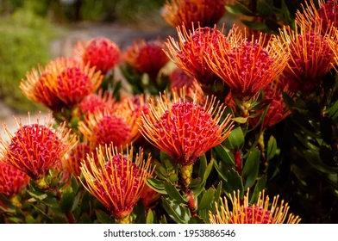
WELCOME TO THE
XIV INTERNATIONAL PROTEA RESEARCH SYMPOSIUM
XIX INTERNATIONAL PROTEA ASSOCIATION CONFERENCE
13-18 March, 2022,
LA PALMA-TENERIFE (SPAIN)
ISHS GROUPS INVOLVED
Division Ornamental Plants- DORN- Chair Dr. Margherita Beruto
Division Plant Genetic Resources and Biotechnology- DBIO- Chair Dr. Prof. Dr. Jorge Canhoto
Workgroup Protea- Chair Ms. Emily Rigby

Slide 2
 | LOCATION | DATE | CONVENERS
XIII | Stellenbosch (South Africa) | September 4, 2017 | U.L. Opara, L. Hoffman & E. Rigby
XII | Perth, WA (Australia) | August 20, 2015 | R. McConchie
XI | Santiago (Chile) | April 22, 2012 | E. Olate
X | Lisbon (Portugal) | August 22, 2010 | K.W. Leonhardt & M. José Leandro
VIII | San Diego, California (USA) | March 30, 2006 | D. Perry
VII | Melbourne, Victoria (Australia) | April 3, 2004 | A.I. Gerber
VI | Wailea, Maui, Hawaii (USA) | March 11, 2002 | K.W. Leonhardt
V | Puerto de la Cruz, Tenerife (Spain) | April 2, 2000 | J.A. Rodrigues-Perez
IX | Stellenbosch (South Africa) | September 3, 2008 | L. Hoffman
IV | Jerusalem (Israel) | March 17, 1996 | J. Ben-Jaacov
III | Harare (Zimbabwe) | October 10, 1993 | G.J. Brits
II | San Diego, CA (USA) | March 7, 1989 | P.E. Parvin
I | Capetown (South Africa) | August 28, 1985 | J.T. Meynhardt

Slide 3
Presentation of the candidates for chairing the Workgroup Protea (Division Ornamental Plants) and election
Presentation of candidates for the XV International Protea Research Symposium and election of the next convener and meeting site
Any other business

Slide 4
Junior scientists to be eligible for the award must be the lead and presenting author of the submission and should be enrolled in a university or college.
He/she can be undergraduate, graduate or postgraduate (limited to 6 months after finishing the program of study), and with an age limit of 35.
ISHS Young Minds Award winners will be invited to write a summary of their research for publication in the magazine Chronica Horticulturae.
A one-year complimentary membership of the ISHS and a Certificate will be awarded to the winners.

Slide 5
International Society Horticultural Science
Global worldwide network of international horticultural co-operation officially registered in 1959
Over 67,000 members comprising individuals, universities, governments, institutions, libraries and commercial companies and some 50 Member Countries/Regions
40 symposia / year Continental symposium (every 2 years) International congress IHC (every 4 years)

Slide 6
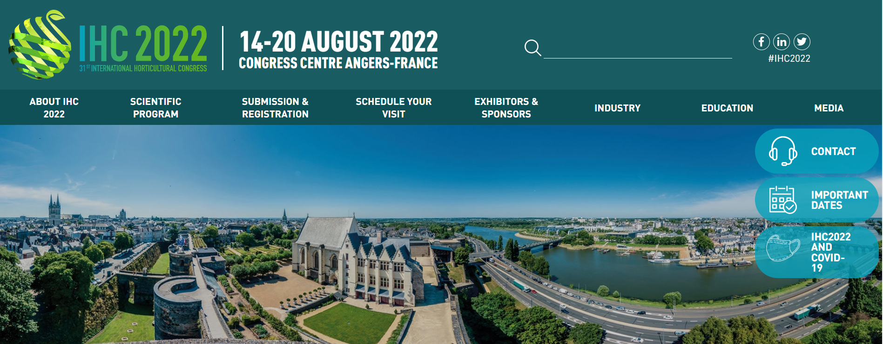
https://www.ihc2022.org/

Slide 7
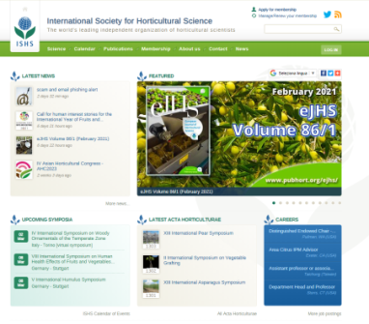
SCIENTIFIC STRUCTURE - 14 DIVISIONS (FROM 2018)
Plant Genetic Resources and Biotechnology
Tropical and Subtropical Fruit and Nuts
Temperate Tree Fruits
Temperate Tree Nuts
Vine and Berry Fruits
Ornamental Plants
Vegetables, Roots and Tubers
Physiology and Plant-Environment Interactions of Horticultural Crops in Field Systems
Protected Cultivation and Soilless Culture
Postharvest and Quality Assurance
Precision Horticulture and Engineering
Horticulture for Human Health
Horticulture for Development
Landscape and Urban Horticulture
approx. 2.540 members
facebook.com/ishs.org
www.ishs.org

Slide 8
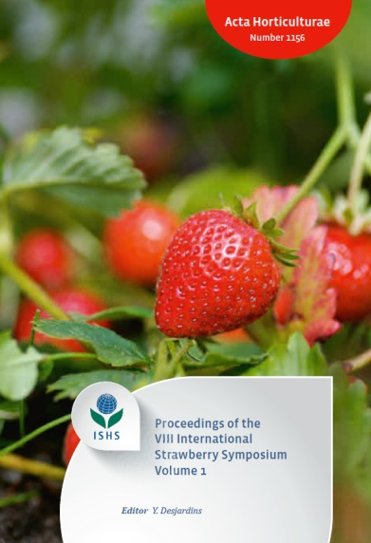
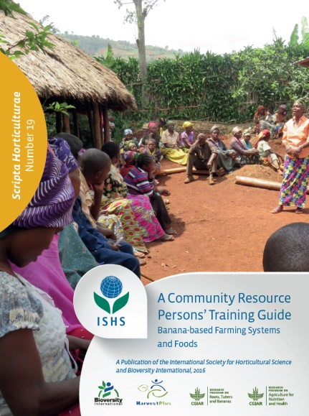
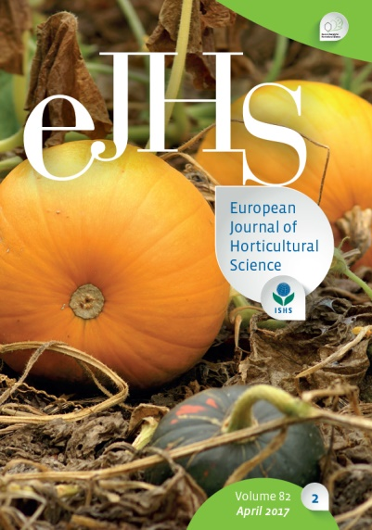
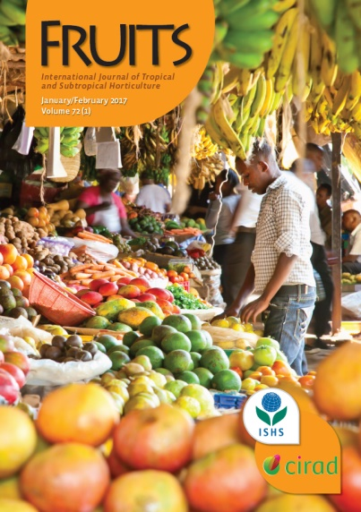
International Society Horticultural Science
https://www.ishs.org/
Acta Horticulturae
Chronica Horticulturae
Scripta Horticulturae
European Journal of Horticultural Science (IF 1,482)
Fruits- The International Journal of Tropical and Subtropical Horticulturae (IF 0,800)

Slide 9
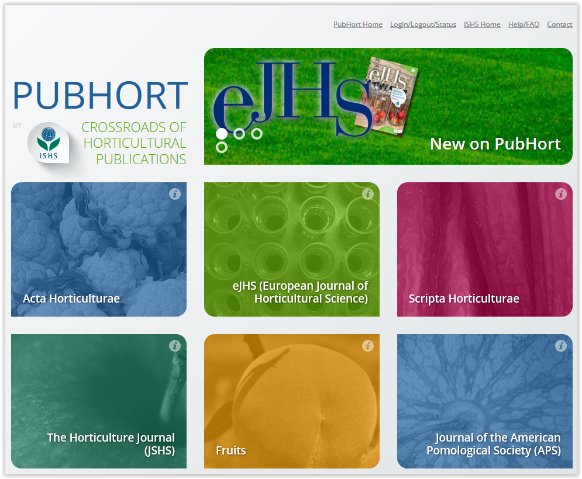
International Society Horticultural Science
https://www.pubhort.org/
Pubhort is a service of ISHS.
PubHort platform aims to provide opportunities not only to ISHS publications but also to other important series of related societies and organisations.

Slide 10
You are welcome to log on to www.ishs.org and apply for ISHS membership

Slide 11
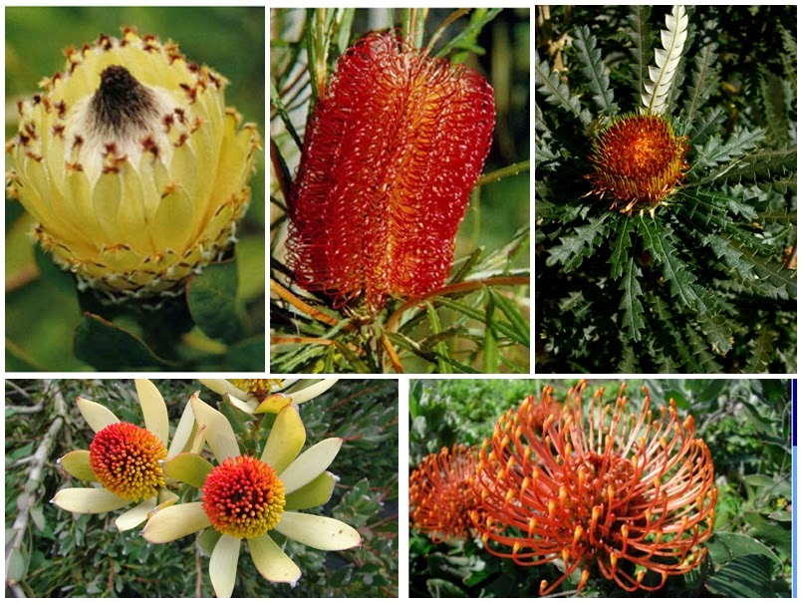
Many thanks and congratulations to
Prof. Dr. Juan Alberto Rodríguez and co-workers
Best wishes for an enjoyable and
very successful symposium

